Slide 1
BPM Calibration Update
E. Brash
August 9, 2018

Slide 2
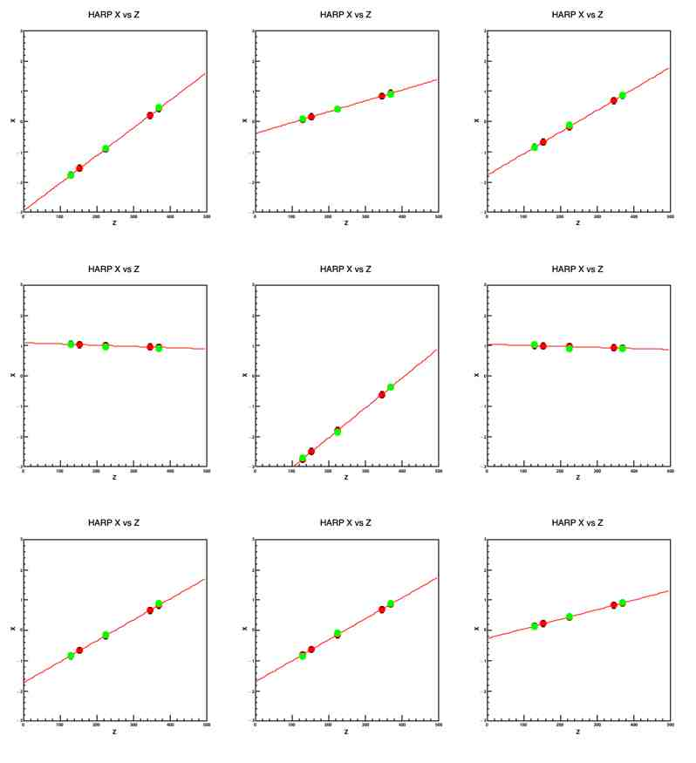
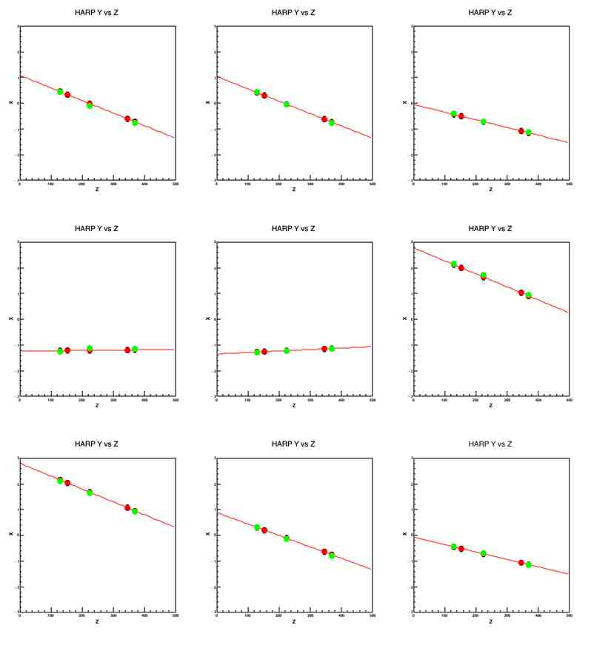
Sanity Checks for Internal Consistency

Slide 3
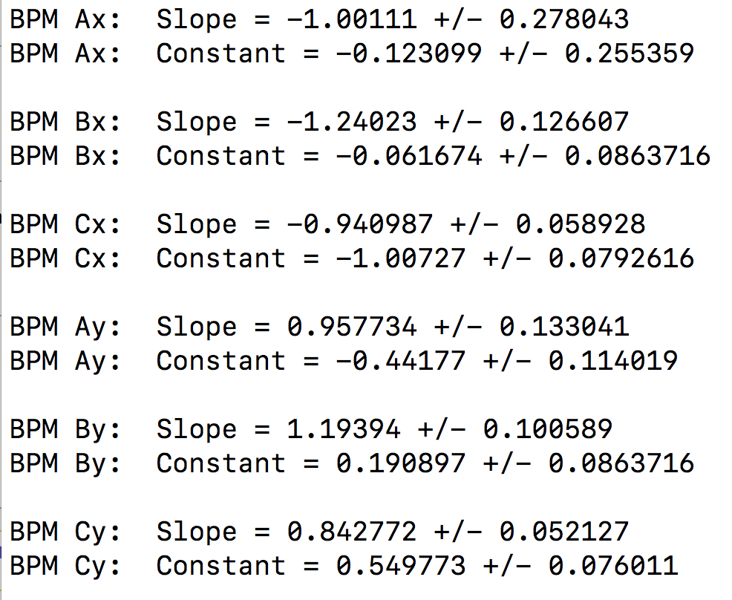
Gains and Offsets
Projected X/Y Position = slope * Raw EPICS BPM X/Y Position + offset
A calibration script now exists in hallc_replay to calculate these parameters, which can then be added to ~/PARAM/GEN/gbeam.param

Slide 4
Beam Position at Target (z = 0)
X(z) = m_{x}*z + b_{x} and Y(z) – m_{y}*z + b_{y}
Calculate slopes from A and C BPM’s (longest lever arm):
m_{x} = (A_{x} – C_{x})/(A_{z} – C_{z}) and m_{y} = (A_{y} – C_{y})/(A_{z} – C_{z})
Then calculate b_{x} and b_{y} (positions at target):
b_{x} = A_{x} – m_{x}*A_{z} and b_{y} = A_{y} – m_{y}*A_{y}
Finally, add raster X and Y values to these offsets to get rastered beam position at the target.

Slide 5
EPICS data in detector classes
The previous algorithm requires the BPM information event by event (as the raster information is event by event).
Need the calibrated BPM information from (last) EPICS event in the THcRaster class.
Steve Wood has added the capability to get the EPICS event handler to the THaAnalyzer class
Requires creating an instance of the THcAnalyzer object in the detector class, and then one can use the various THaAnalyzer Get* methods to get the THaEpicsEvtHandler event handler object, and in turn one can use then the various THaEpicsEvtHandler Get* methods to get the EPICS data of interest.

Slide 6
THcRaster.h
#include "THaEpicsEvtHandler.h"
protected:
THaEpicsEvtHandler* fEpicsHandler;
THcRaster.cxx
(in somewhere like the ReadDatabase method … )
THcAnalyzer *analyzer = dynamic_cast<THcAnalyzer*>(THcAnalyzer::GetInstance());
fEpicsHandler = analyzer->GetEpicsEvtHandler();
(in the Decode method … )
if (fEpicsHandler) {
if (fEpicsHandler->IsLoaded("IPM3H07A.XRAW")){
BPMXA_raw = atof(fEpicsHandler->GetString("IPM3H07A.XRAW"));
}
}
N.B. Need to be careful with units!!! BPM calibrations are in mm, raster is in cm currently!!

Slide 7
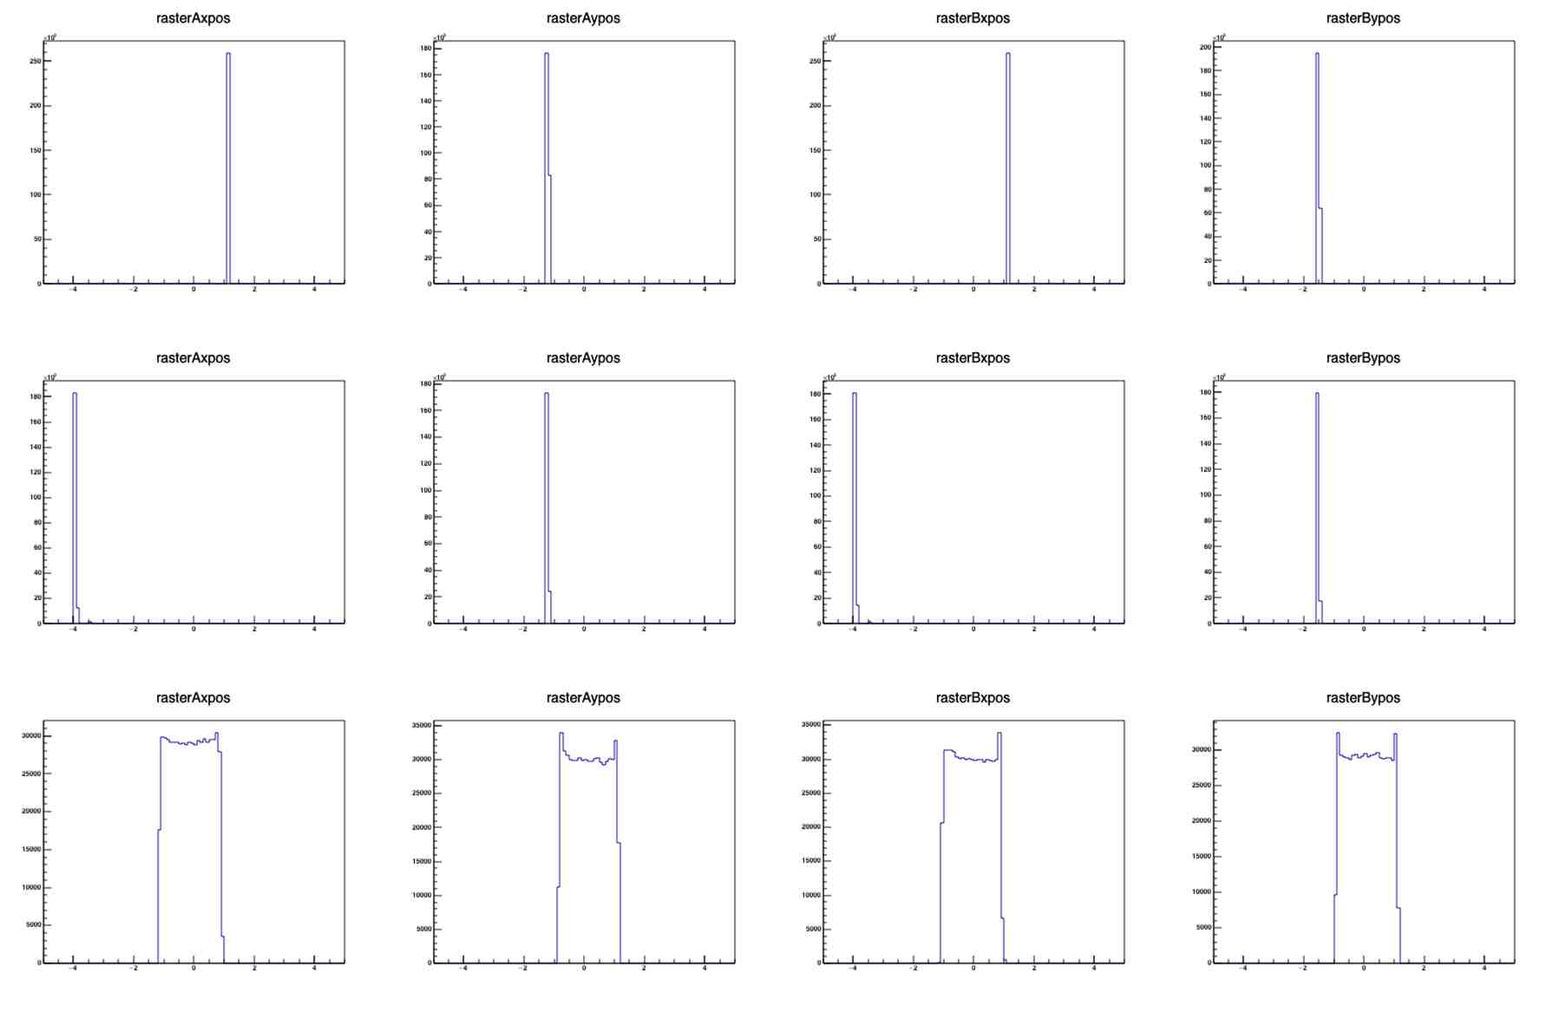

Slide 8
